Slide 1
Silver Mining in
Ancient Rome
Joseph De Riso

Slide 2
What did the ancient Romans mine?
Early Romans primarily mined metal for tools, such as copper, lead, tin, and iron. Metals such as iron had practical uses, such as for weapons like swords, spears, shields and armor. However, two other precious metals were also heavily mined, being gold and silver.

Slide 3
Why silver?
Silver was valued for its physical appearance, rather than practical use. Ancient Romans would shape jewelry, or figurines out of it. Silver would also be used in creating ritual objects.
Silvers allure came in the creation of the “Hacksilver”. Hacksilver was an original form of wealth storage. It was the preferable metal when minting coins.

Slide 4
Roman Coins
Romans first created silver coins in the early 3rd century BCE. The Roman culture was heavily derived from the Greeks before them, and their coins were no exception. In 211 BCE , a new coin was introduced. The silver Denarius, or plural denarii. This coin would stand as the central currency for five hundred years, until the 3rd century CE.
In 167 BCE, the Romans laid siege to the west, taking silver mines from the ancient Macedonians. Following this transfer of new found silver mines, there was an influx of available silver. Over time, decadence would plague Roman leadership. Emperors would spend endlessly, draining the civilizations wealth. Silver coins went from almost pure, to seventy percent, eventually reaching an all time low of only two percent silver.

Slide 5
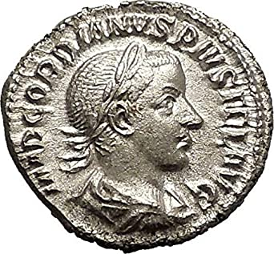

Slide 6
How did the Romans mine silver
The surge of this precious metal did not come without grueling labor. Romans used three primary methods of recovering the ore.
-The easiest method the Romans used was gathering the ore directly from the surface of streams. Rushing water would destroy deposits, exposing the ore and creating lose silver.
-Once these deposits were located, they could follow these shallow veins into the ground. They could then dig short tunnels, strip mining the surface.
-The third method was much more trying. After a rich vein was found, tunnels were excavated in the rock to remove the ore. Narrow vertical shafts were driven through the rock, widening out the space where the ore was discovered. It was very dangerous working below ground, as the miners had to deal with the need for lighting, poor ventilation, or water flooding the excavation site.

Slide 8
Man power
These jobs took massive amounts of man power to coordinate and orchestrate without failure. The ancient Romans would work some 40,000 slaves in the silver mines. Many mines would would have to stop at the water table. Slaves and prisoners alike would be forced to work the silver mines. Slaves were used to bail water out while excavating. The seemingly endless amount of slave labor Rome had allowed work to be done on a trial and error basis, deaths in the work site were commonplace.

Slide 9
Conclusion
Overall, mining silver was an extremely arduous and labor intensive task. Many would face death from either the working conditions, or over exhaustion.
By the later Roman period, as the empire grew more powerful, silver was traded from Britain, Germany, and the Balkans. Traded as coinage with the people of ancient India in exchange for spices and luxury goods. It was then converted back into silver ingots or (bullions) by the Indians.

Slide 10
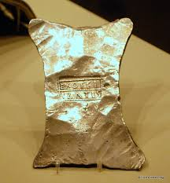

Slide 11
Bibliography
“ANCIENT MINING.” Earth Science Australia Home Page, Earth Science Australia, http://earthsci.org/mineral/mindep/ancient_mine/deep-vein_mining.html. Accessed 24 Feb. 2021.
Cartwright, Mark. "Silver in Antiquity." Ancient History Encyclopedia. Ancient History Encyclopedia, 19 Sep 2017. Web. 20 Feb 2021.

